Slide 1
Chapter 9
Pointers
Objectives
❏ To understand the concept and use of pointers
❏ To be able to declare, define, and initialize pointers
❏ To write programs that access data through pointers
❏ To use pointers as parameters and return types
❏ To understand pointer compatibility, especially regarding pointers to pointers
❏ To understand the role of quality in software engineering

Slide 2
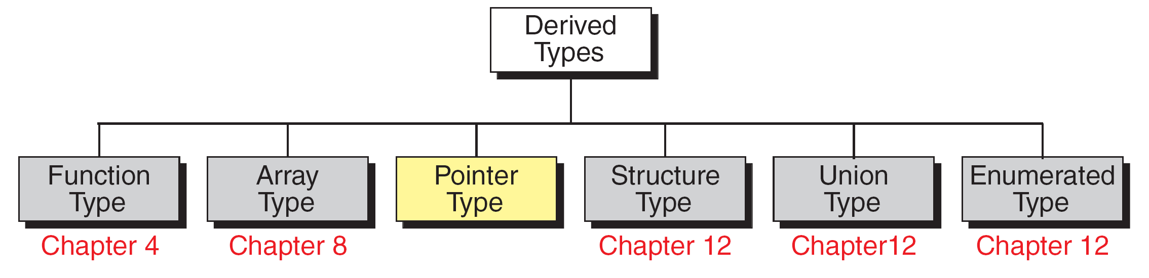
FIGURE 9-1 Derived Types

Slide 3
9-1 Introduction
A pointer is a constant or variable that contains an address that can be used to access data. Pointers are built on the basic concept of pointer constants.
Topics discussed in this section:
Pointer Constants
Pointer Values
Pointer Variables
Accessing Variables Through Pointers
Pointer Declaration and Definition
Declaration versus Redirection
Initialization of Pointer Variables

Slide 4
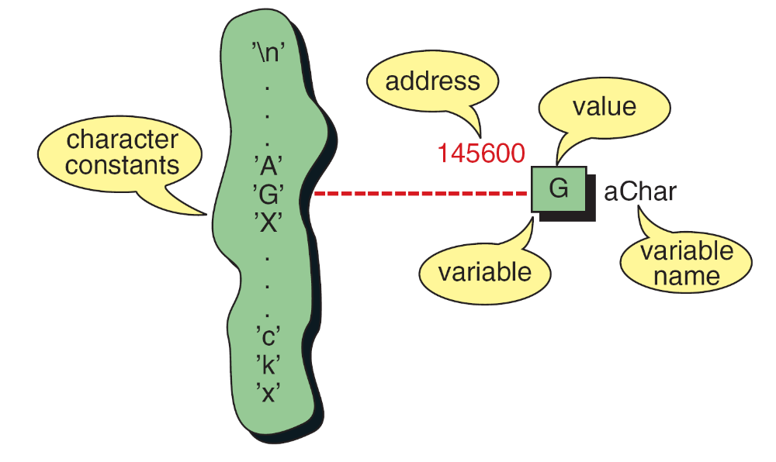
FIGURE 9-2 Character Constants and Variables

Slide 5
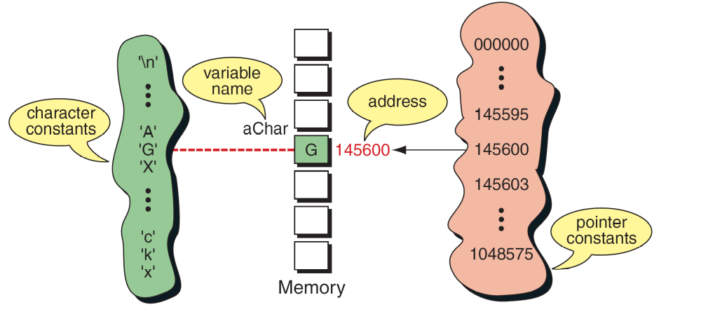
FIGURE 9-3 Pointer Constants

Slide 6
Note
Pointer constants, drawn from the set of addresses for a computer, exist by themselves. We cannot change them;
we can only use them.

Slide 7
Note
An address expression, one of the expression types in the unary expression category, consists of an ampersand (&) and a variable name.

Slide 8
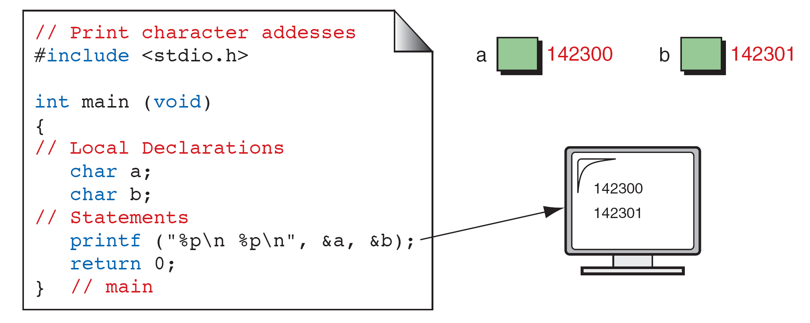
FIGURE 9-4 Print Character Addresses

Slide 9
Note
A variable’s address is the first byte occupied
by the variable.

Slide 10
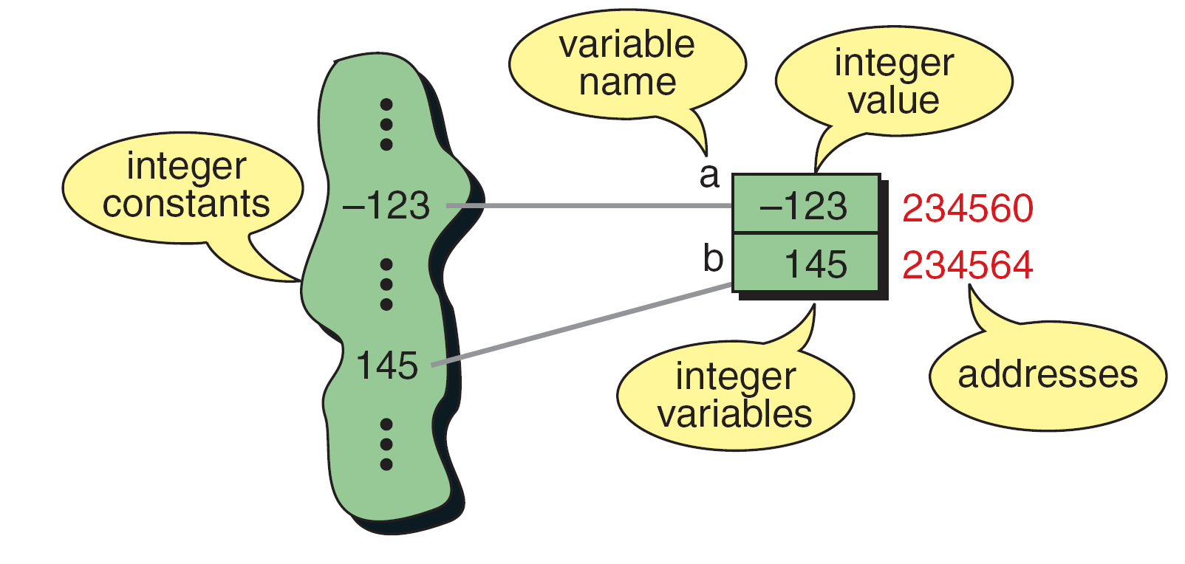
FIGURE 9-5 Integer Constants and Variables

Slide 11
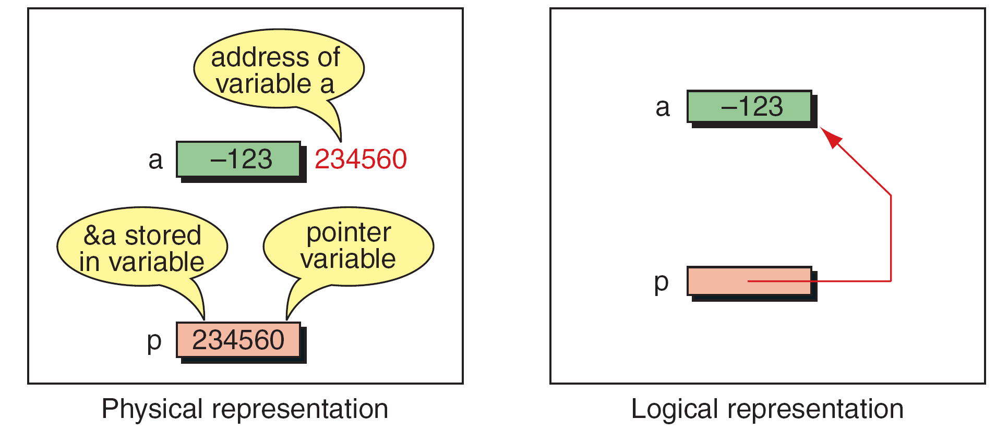
FIGURE 9-6 Pointer Variable

Slide 12
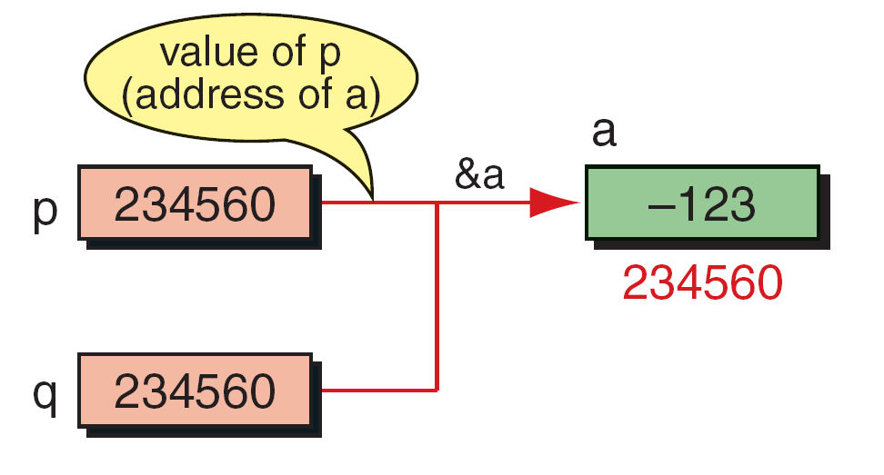
FIGURE 9-7 Multiple Pointers to a Variable

Slide 13
Note
A pointer that points to no variable contains the
special null-pointer constant, NULL.

Slide 14
Note
An indirect expression, one of the expression types in the unary expression category, is coded with an
asterisk (*) and an identifier.

Slide 15
FIGURE 9-8 Accessing Variables Through Pointers

Slide 16

FIGURE 9-9 Address and Indirection Operators

Slide 17
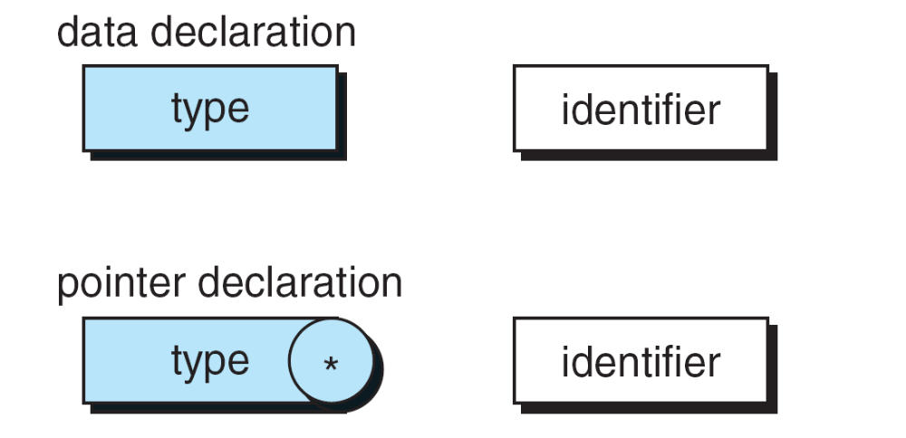
FIGURE 9-10 Pointer Variable Declaration

Slide 18
FIGURE 9-11 Declaring Pointer Variables

Slide 19
PROGRAM 9-1
Demonstrate Use of Pointers

Slide 20
PROGRAM 9-1
Demonstrate Use of Pointers

Slide 21
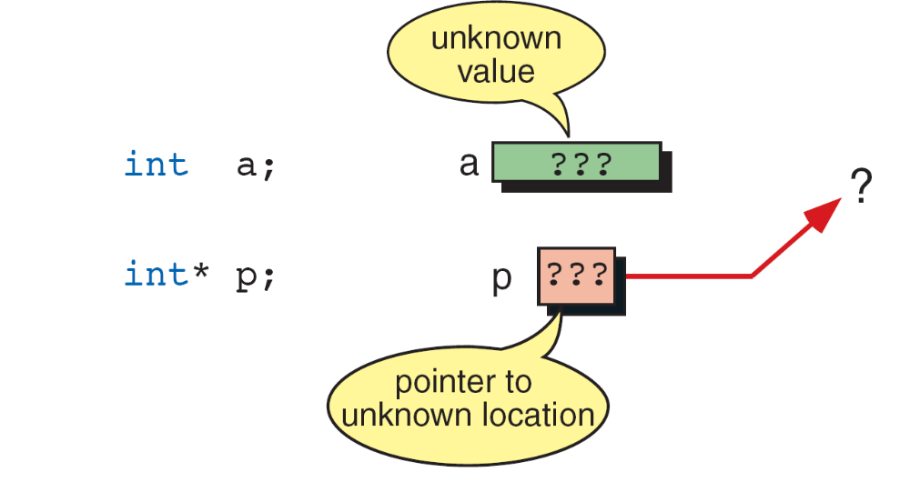
FIGURE 9-12 Uninitialized Pointers

Slide 22
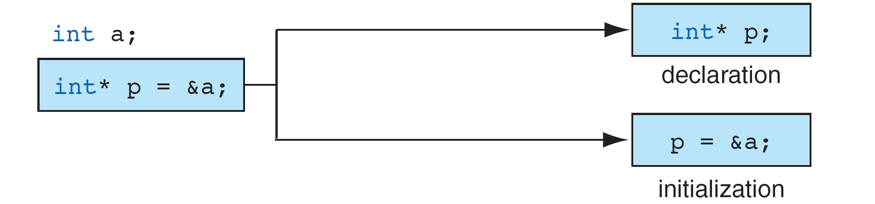
FIGURE 9-13 Initializing Pointer Variables

Slide 23
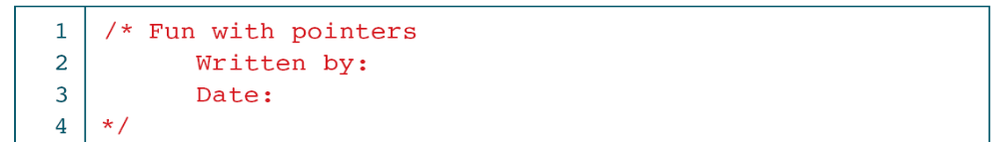
PROGRAM 9-2
Fun with Pointers

Slide 24
PROGRAM 9-2
Fun with Pointers

Slide 25
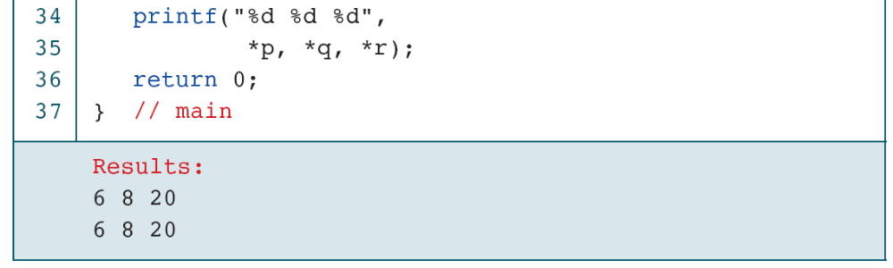
PROGRAM 9-2
Fun with Pointers

Slide 26
FIGURE 9-14 Add Two Numbers Using Pointers

Slide 27
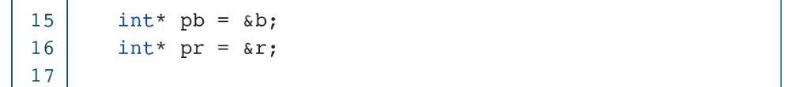
PROGRAM 9-3
Add Two Numbers Using Pointers

Slide 28
PROGRAM 9-3
Add Two Numbers Using Pointers

Slide 29
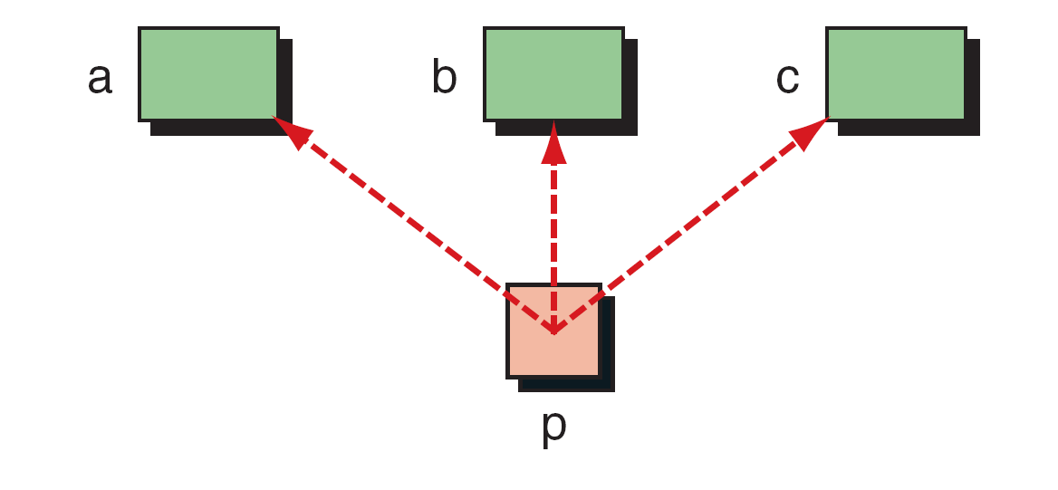
FIGURE 9-15 Demonstrate Pointer Flexibility

Slide 30
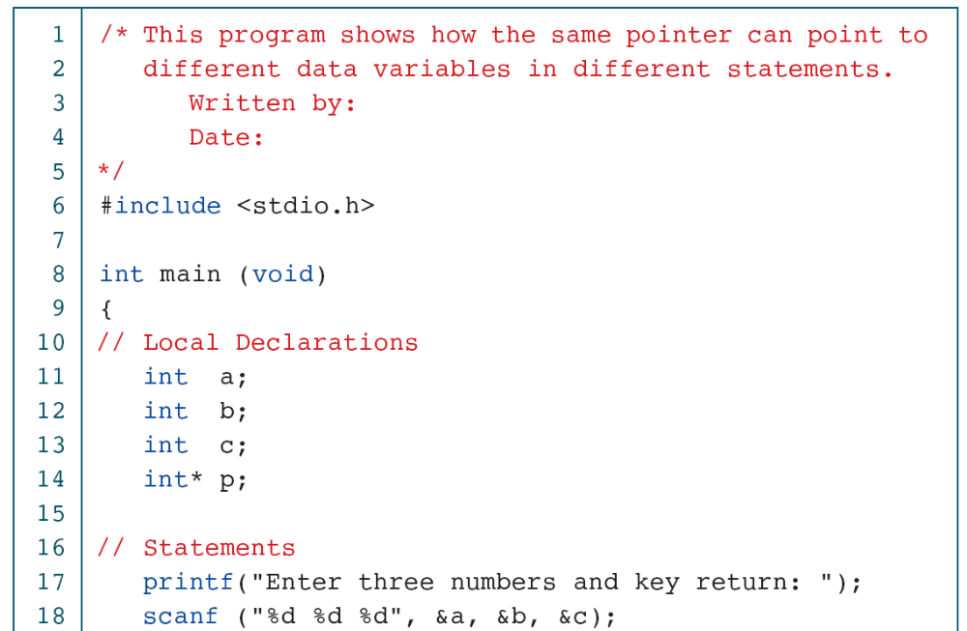
PROGRAM 9-4
Using One Pointer for Many Variables

Slide 31
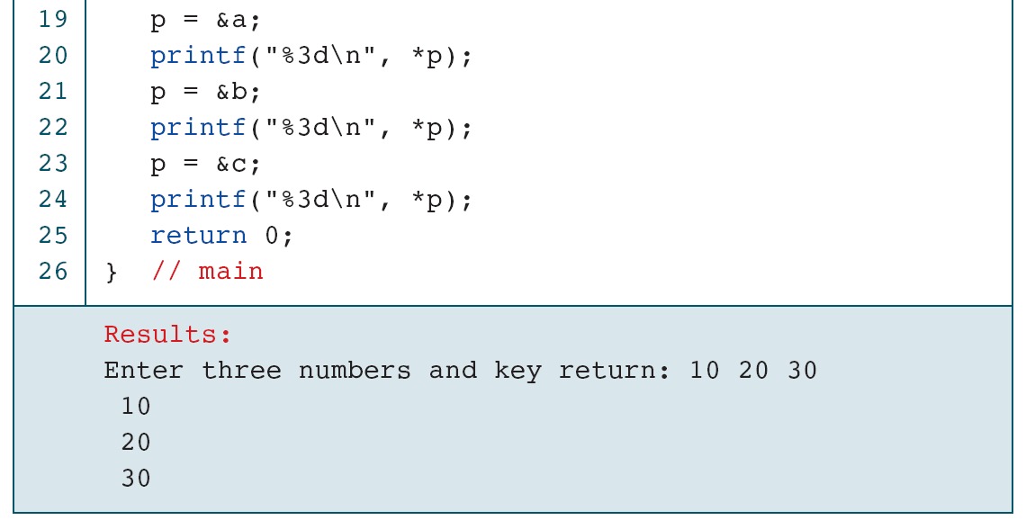
PROGRAM 9-4
Using One Pointer for Many Variables

Slide 32
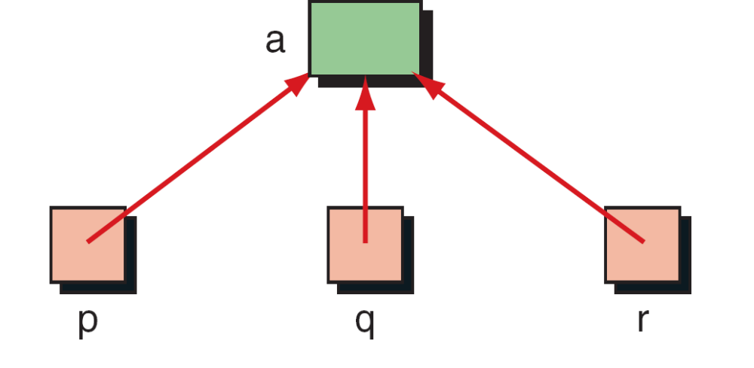
FIGURE 9-16 One Variable with Many Pointers

Slide 33
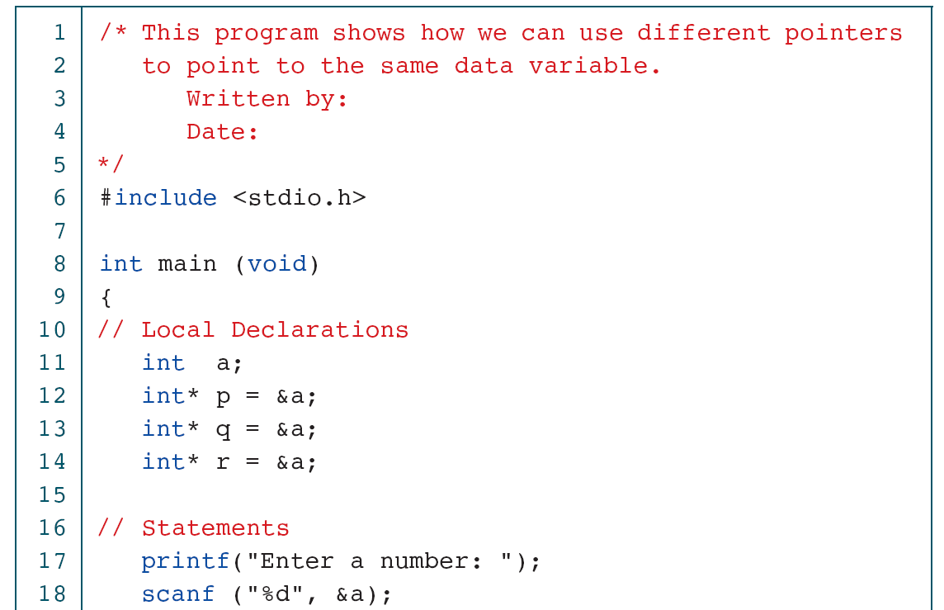
PROGRAM 9-5
Using A Variable with Many Pointers

Slide 34
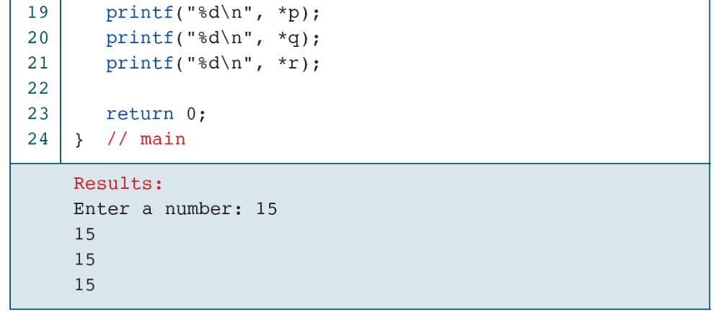
PROGRAM 9-5
Using A Variable with Many Pointers

Slide 35
9-2 Pointers for Inter-function
Communication
One of the most useful applications of pointers is in functions. When we discussed functions in Chapter 4, we saw that C uses the pass-by-value for downward communication. For upward communication, we normally pass an address. In this section, we fully develop the bi-directional communication.
Topics discussed in this section:
Passing Addresses
Functions Returning Pointers

Slide 36
FIGURE 9-17 An Unworkable Exchange

Slide 37
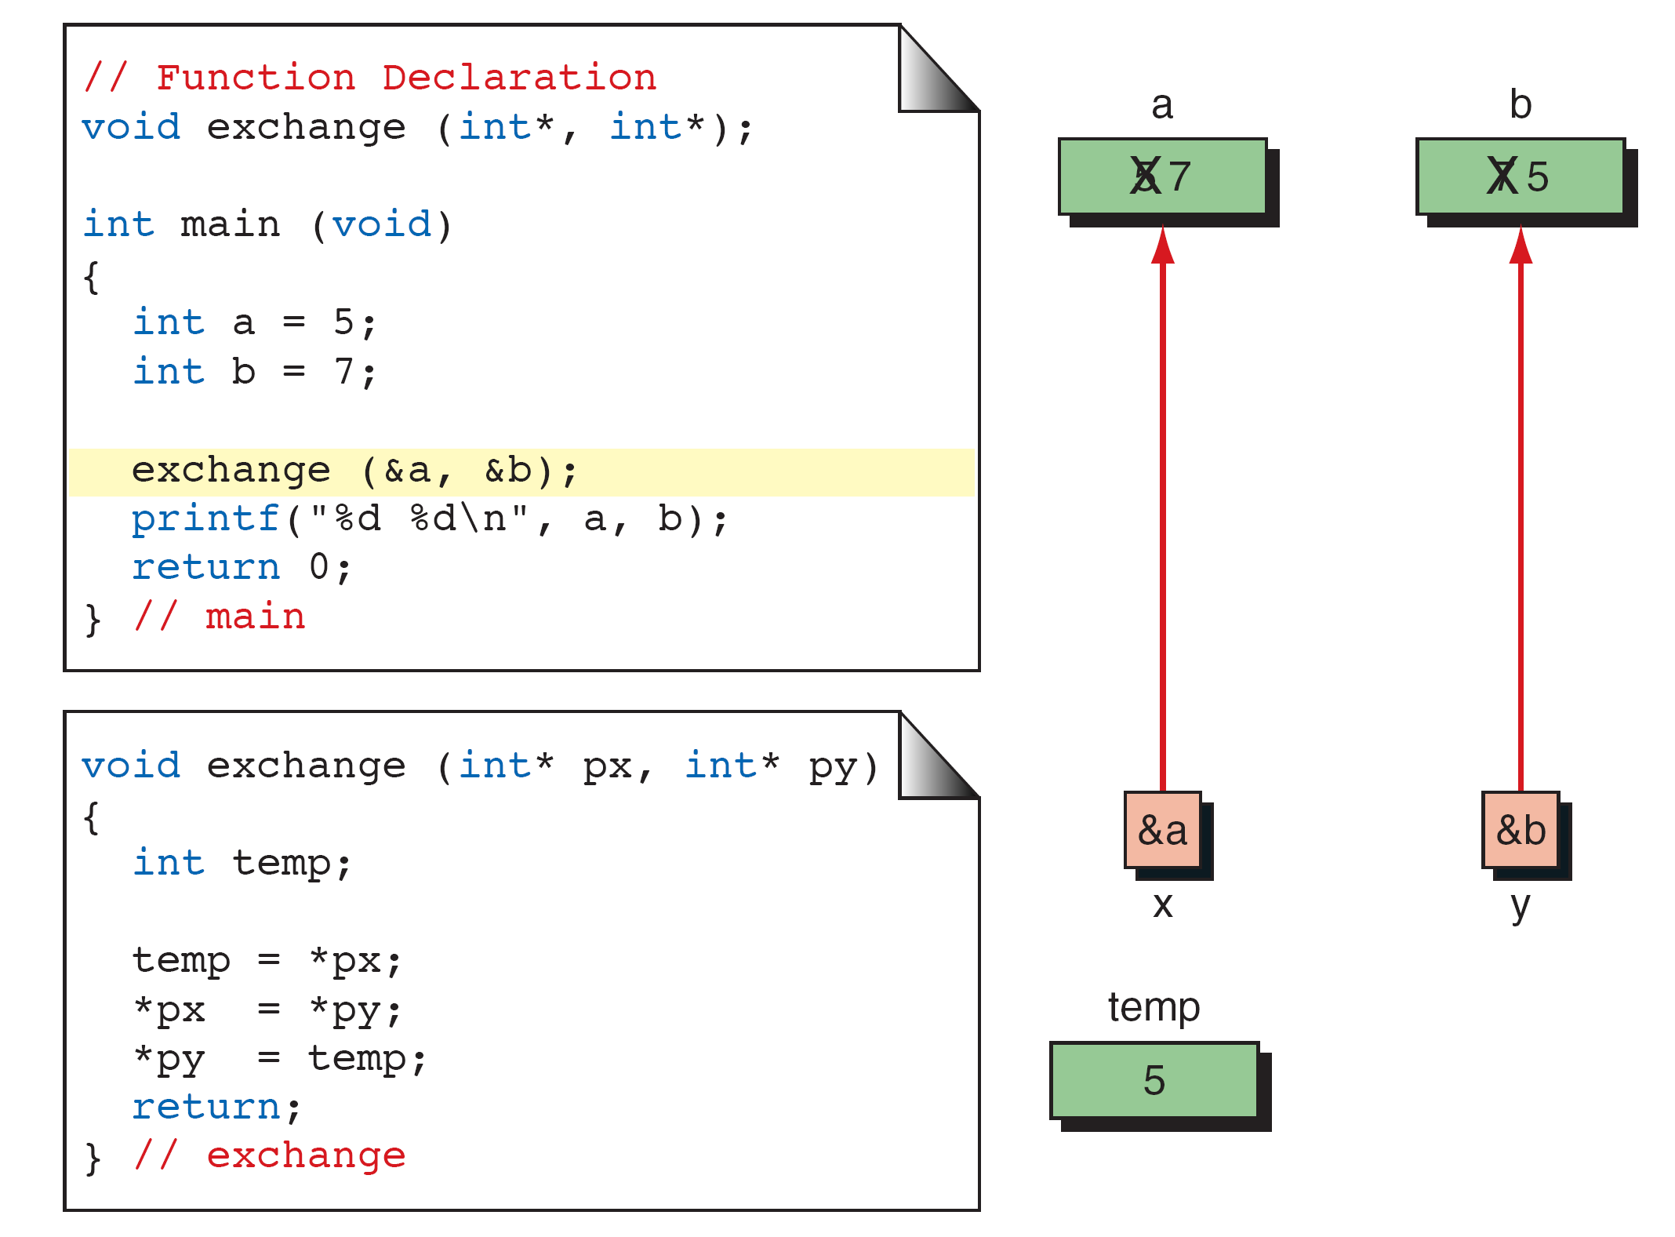
FIGURE 9-18 Exchange Using Pointers

Slide 38
Note
Every time we want a called function to have access to a variable in the calling function, we pass the address
of that variable to the called function and use
the indirection operator to access it.

Slide 39
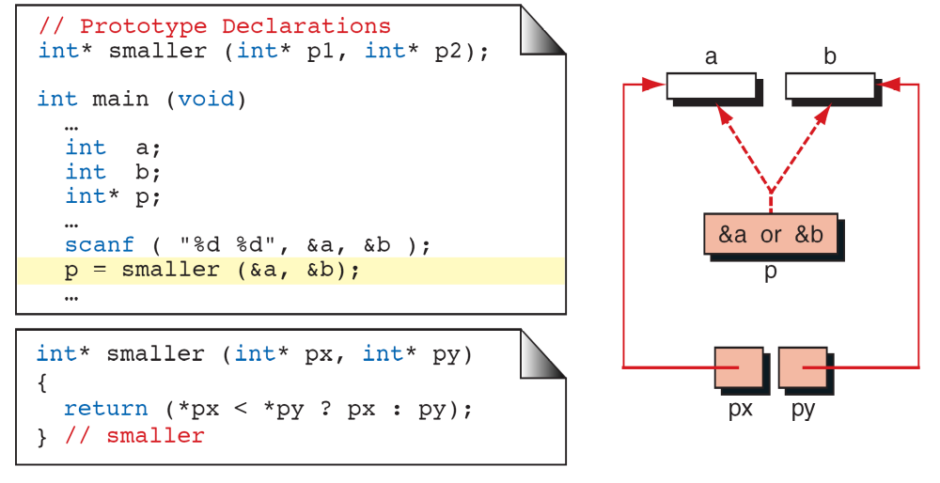
FIGURE 9-19 Functions Returning Pointers

Slide 40
Note
It is a serious error to return a pointer to a local variable.

Slide 41
9-3 Pointers to Pointers
So far, all our pointers have been pointing directly to data. It is possible—and with advanced data structures often necessary—to use pointers that point to other pointers. For example, we can have a pointer pointing to a pointer to an integer.

Slide 42
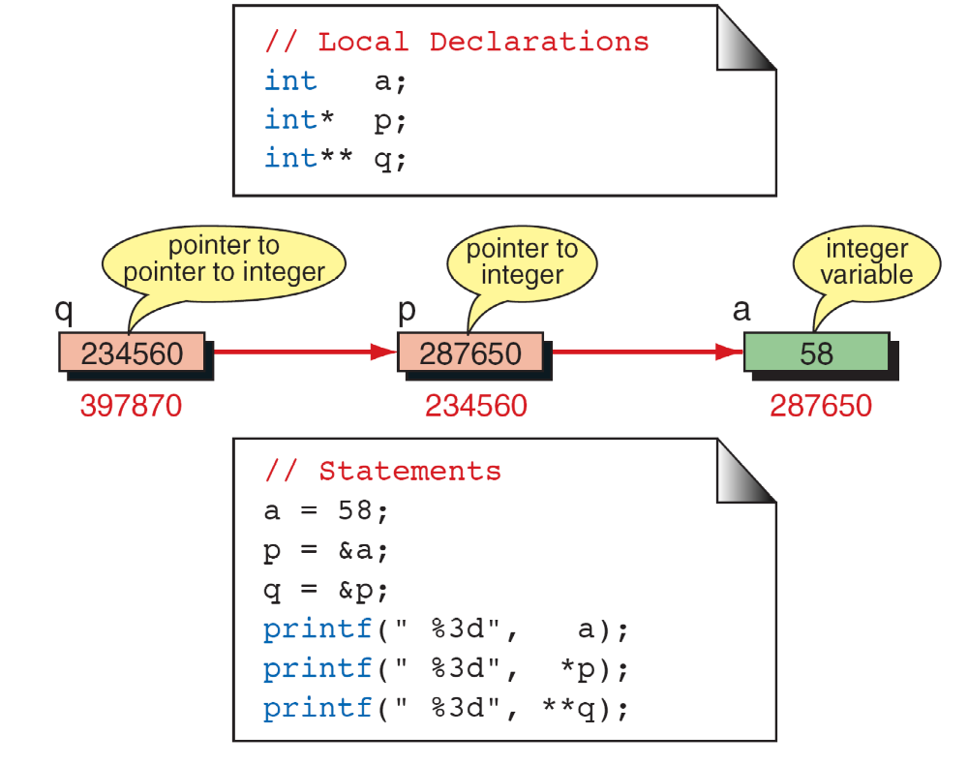
FIGURE 9-20 Pointers to Pointers

Slide 43
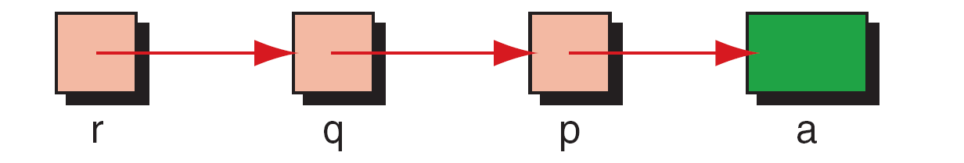
FIGURE 9-21 Using Pointers to Pointers

Slide 44
PROGRAM 9-6
Using pointers to pointers

Slide 45
PROGRAM 9-6
Using pointers to pointers

Slide 46
PROGRAM 9-6
Using pointers to pointers

Slide 47
9-4 Compatibility
It is important to recognize that pointers have a type associated with them. They are not just pointer types, but rather are pointers to a specific type, such as character. Each pointer therefore takes on the attributes of the type to which it refers in addition to its own attributes.
Topics discussed in this section:
Pointer Size Compatibility
Dereference Type Compatibility
Dereference Level Compatibility

Slide 48
PROGRAM 9-7
Demonstrate Size of Pointers

Slide 49
PROGRAM 9-7
Demonstrate Size of Pointers

Slide 50
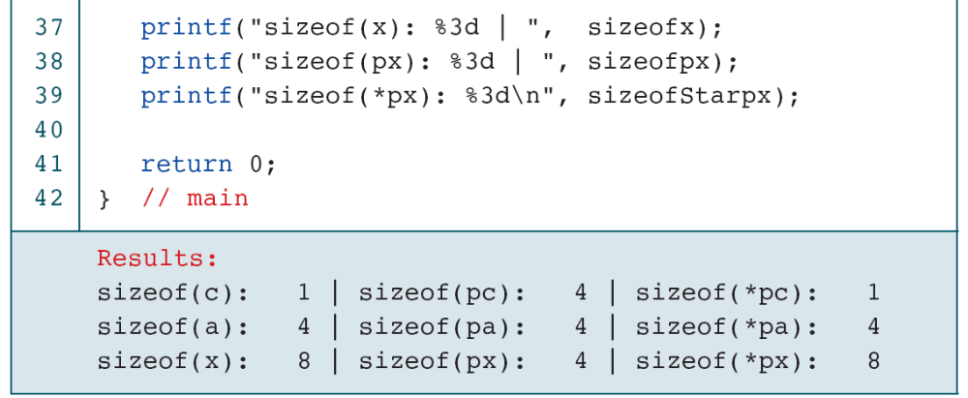
PROGRAM 9-7
Demonstrate Size of Pointers

Slide 51
FIGURE 9-22 Dereference Type Compatibility

Slide 52
Note
A void pointer cannot be dereferenced.

Slide 53
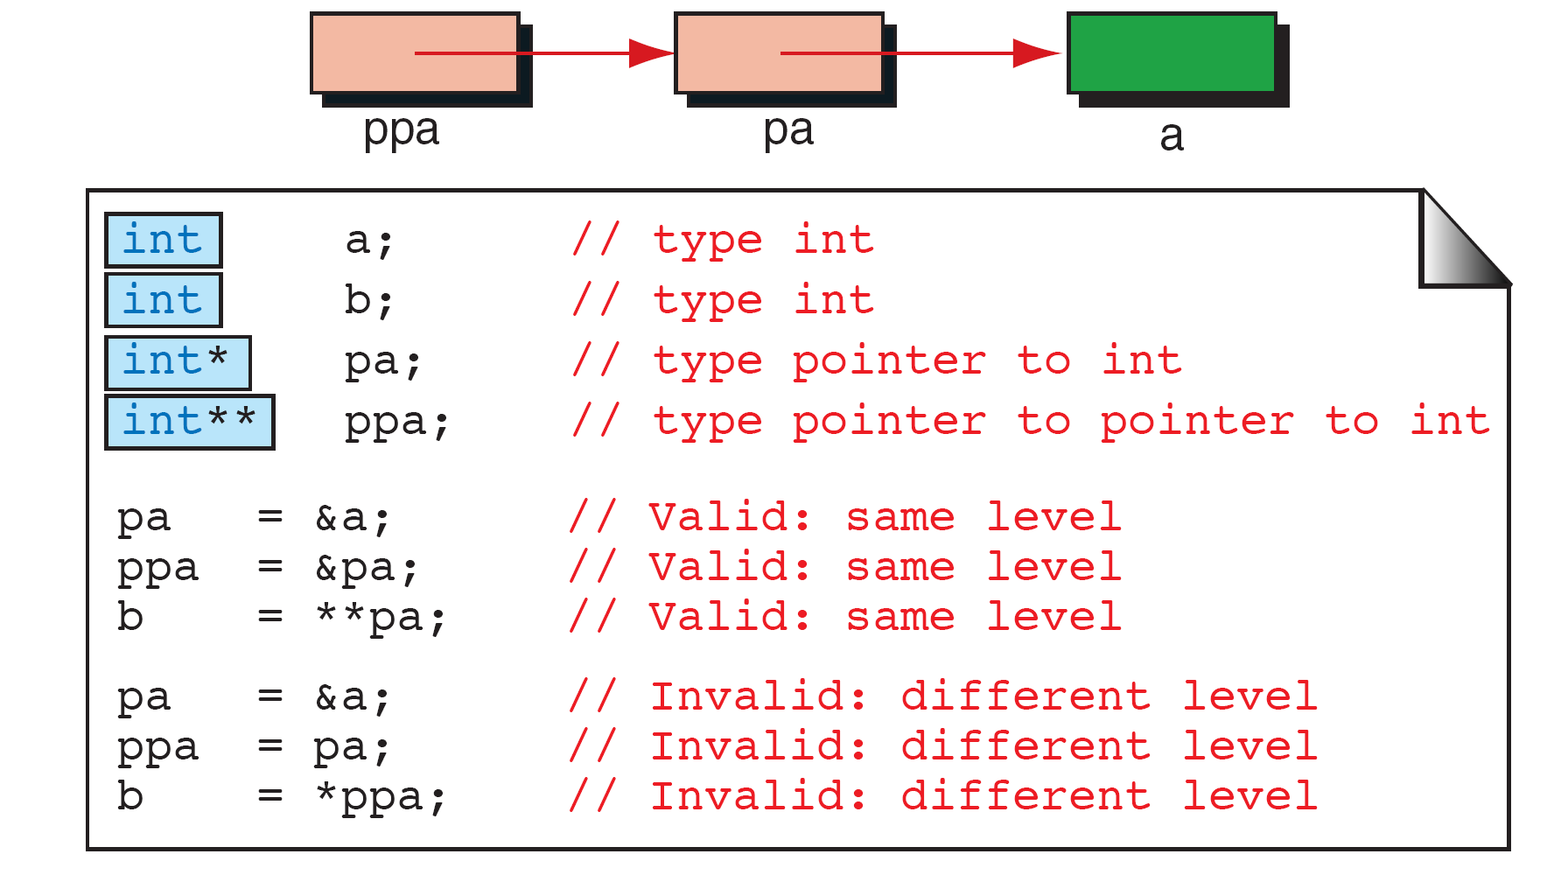
FIGURE 9-23 Dereference Level Compatibility

Slide 54
9-5 Lvalue and Rvalue
In C, an expression is either an lvalue or an rvalue. As you know, every expression has a value. But the value in an expression (after evaluation) can be used in two different ways.
Topics discussed in this section:
Pointer Examples

Slide 55
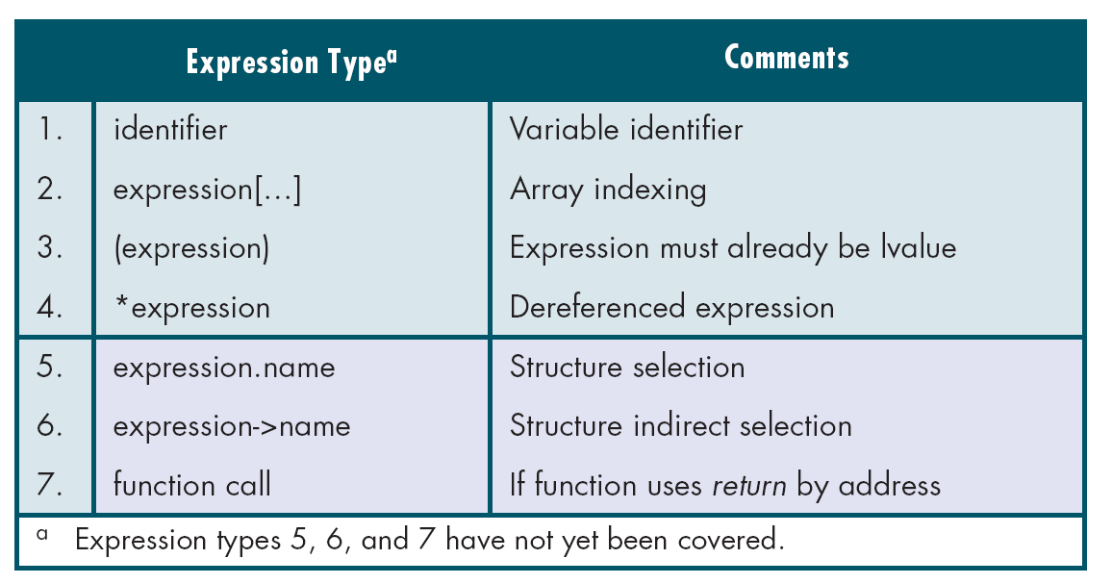
Table 9-1
lvalue Expressions

Slide 56
Note
The right operand of an assignment operator must be an rvalue expression.

Slide 57
Table 9-2
Operators That Require lvalue Expressions

Slide 58
Table 9-3
Invalid rvalue Expressions

Slide 59
PROGRAM 9-8
Convert Seconds to Hours, Minutes, and Seconds

Slide 60
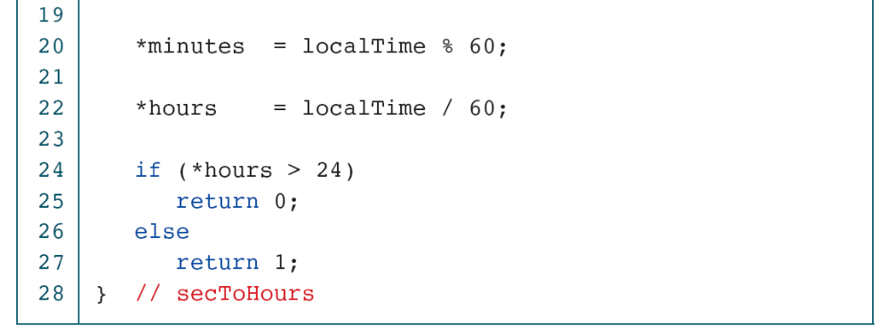
PROGRAM 9-8
Convert Seconds to Hours, Minutes, and Seconds

Slide 61
Note
Create local variables when a value parameter will be changed within a function so that the original
value will always be available for processing.

Slide 62
Note
When several values need to be sent back to the calling function, use address parameters for all of them.
Do not return one value and use address
Parameters for the others.

Slide 63
FIGURE 9-24 A Common Program Design

Slide 64
FIGURE 9-25 Using Pointers as Parameters

Slide 65
PROGRAM 9-9
Quadratic Roots

Slide 66
PROGRAM 9-9
Quadratic Roots

Slide 67
PROGRAM 9-9
Quadratic Roots

Slide 68
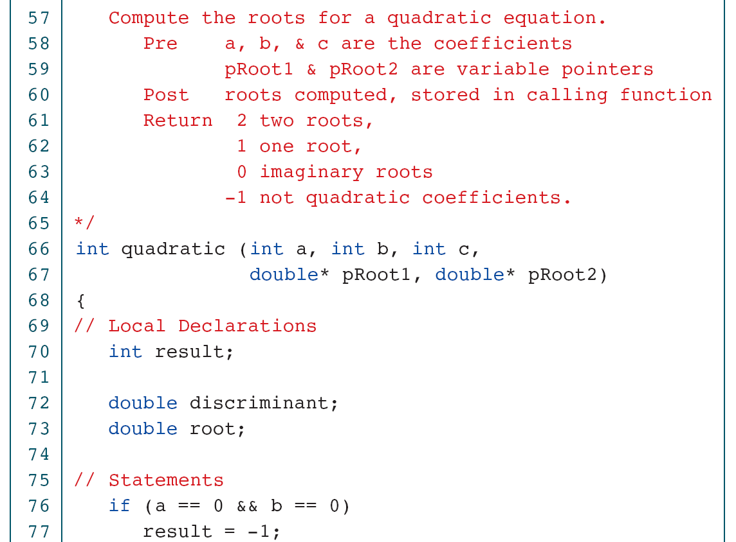
PROGRAM 9-9
Quadratic Roots

Slide 69
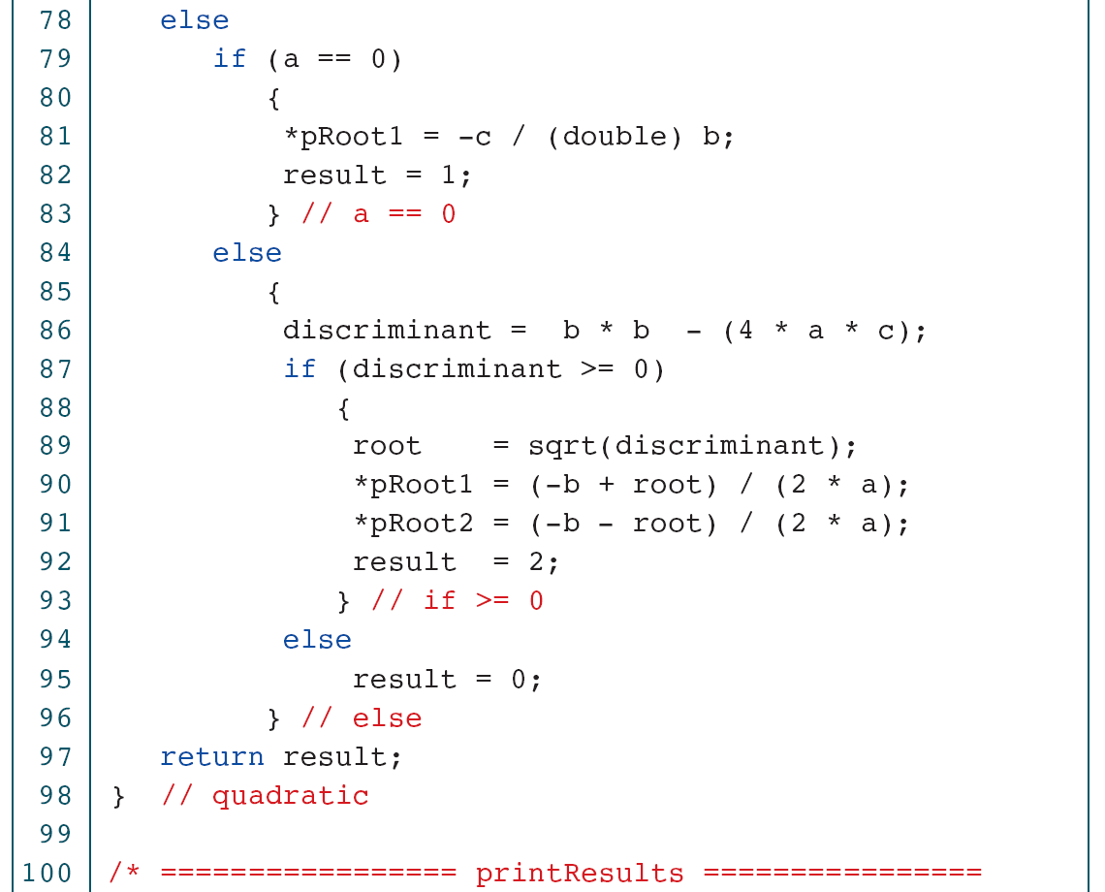
PROGRAM 9-9
Quadratic Roots

Slide 70
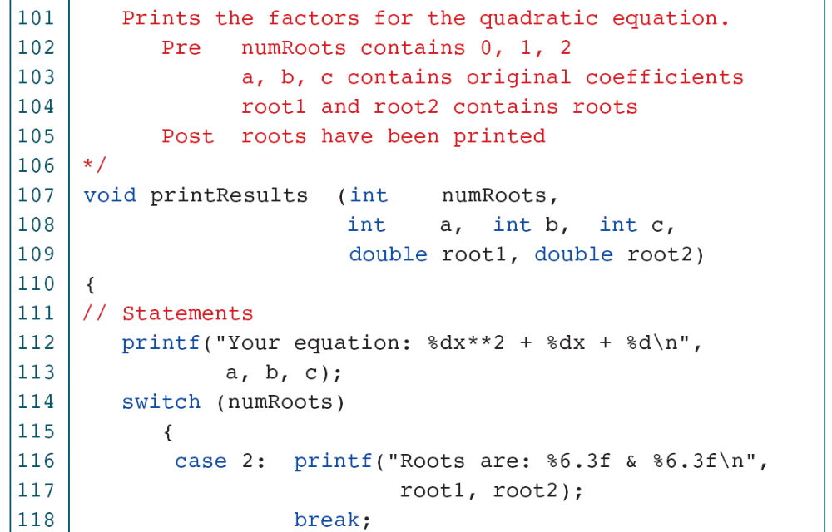
PROGRAM 9-9
Quadratic Roots

Slide 71
PROGRAM 9-9
Quadratic Roots

Slide 72
PROGRAM 9-9
Quadratic Roots

Slide 73
9-6 Software Engineering
In this chapter, we discuss a general software engineering topic, quality, which can be applied to any topic, including pointers.
Topics discussed in this section:
Quality Defined
Quality Factors
The Quality Circle
Conclusion

Slide 74
Note
Software that satisfies the user’s explicit and implicit requirements, is well documented, meets the
operating standards of the organization,
and runs efficiently on the hardware
for which it was developed.

Slide 75
FIGURE 9-26 Streams

Slide 76
FIGURE 9-27 Streams

